Slide 1
Multiple Forms of Oppression and Privilege
Notes:
An instructional lesson will need to be done on key quantitative concepts prior to assigning the module. Here is a sample PowerPoint to illustrate the concepts. I highly recommend demonstrating the use of WebChip to look at a similar research question to the one the module asks the students to answer.

Slide 2
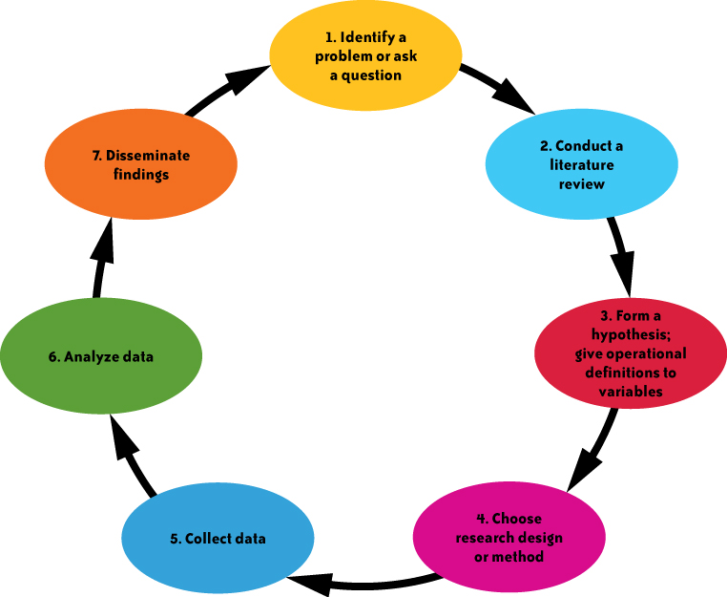
The Scientific Method
Steps 1-7...
Notes:
Note that we are focusing on steps 3 and 6 for this module.

Slide 3
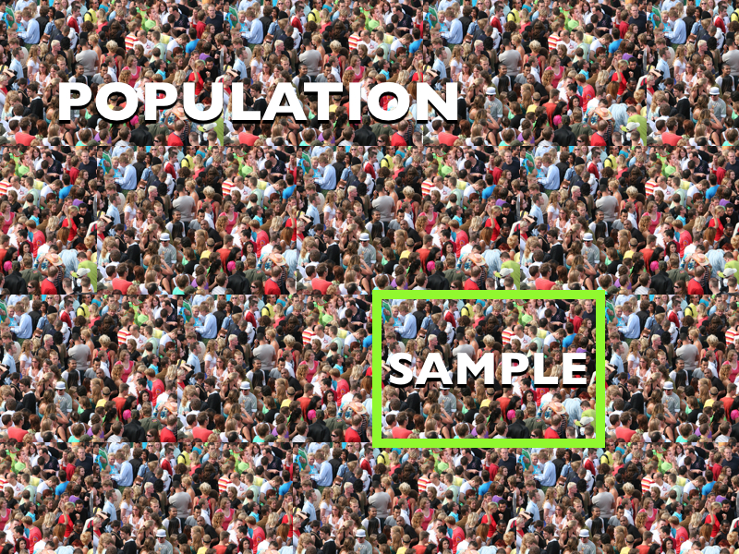
Notes:
Discuss the difference between a population and a sample. Explain that we are using Census data, which is based on the U.S. population.

Slide 4
Variables
Independent variables
Dependent variables
Bivariate Analysis
Control Variables
Notes:
Provide students with the definitions to these key terms.

Slide 5
Variables
Identify the independent and dependent variables in the following statements.
1) It has been documented that men have worse mental health than women.
2) People with higher levels of education are less likely to exhibit bigoted attitudes.
3) Racial minorities are more likely than white people to experience police brutality.
Notes:
Have students do the applied exercise.

Slide 6
Research Methods
Education → Bigoted Attitudes
Other factors?
Notes:
Ask students to come up with control variables that should be included in this statistical model.

Slide 7
Key Research Concepts
Hypotheses
H₁: Women are less likely to be employed than men.
H₂: Women are less likely to be employed than men, even when controlling for race.
Notes:
Explain what hypotheses are and show examples. H₁ is a hypothesis for the bivariate relationship. H₂ is the hypothesis when including a control variable. You might also address null hypotheses.

Slide 8
Notes:
Walk students through how to read the marginals for datasets in WebChip. Explain the importance of understanding descriptive statistics for a population or sample.

Slide 9
Is there a relationship between gender and employment status?
Remember, compare across.
Men are more likely than women to be employed. 81% of men are employed, compared with 77% of women.
Hypothesis supported
Notes:
Explain how to read a bivariate table. The example displayed here investigates whether there is a relationship between gender and employment status. Make note of the major finding as a class.

Slide 10
Do the findings hold when controlling for race?
Among whites, men are more likely to be employed than women. For example, 81% of white men report being employed, compared to 78% of white women.
Hypothesis supported
Notes:
Explain that controls have now been added, allowing us to see whether this pattern holds for all racial groups represented in census data. As a class, analyze whether the initial pattern holds for non-Latino/a whites.

Slide 11
Do the findings hold when controlling for race?
The relationship does not hold when looking at Black Americans. In fact, Black women are slightly more likely to be employed than Black men. For example 76% of Black women report being employed, compared to 73% of Black men.
X Relationship changes!
Notes:
As a class, analyze whether the initial pattern holds for Black Americans. Note that the percentage difference is small.

Slide 12
Do the findings hold when controlling for race?
The relationship holds when looking at Asian Americans. Among Asian Americans, men are more likely than women to be employed. For example 84% of Asian men are employed, compared to 80% of Asian women.
Hypothesis supported
Notes:
As a class, analyze whether the initial pattern holds for Asian Americans.

Slide 13
Do the findings hold when controlling for race?
The relationship holds when looking at Latino/a Americans. Among Latino/a Americans, men are more likely than women to be employed. For example 85% of Latino men are employed, compared with 78% of Latina women.
Hypothesis supported
Notes:
As a class, analyze whether the initial pattern holds for Latino/a people. Discuss the larger conclusions that can be reached after controlling for race.

Slide 14
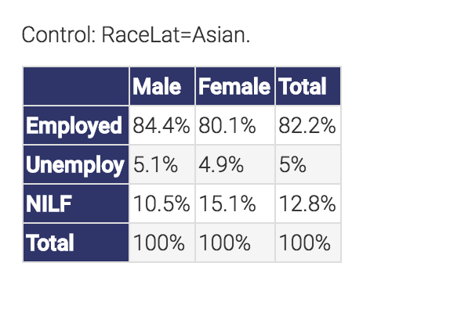
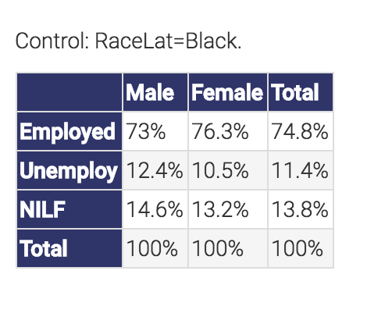
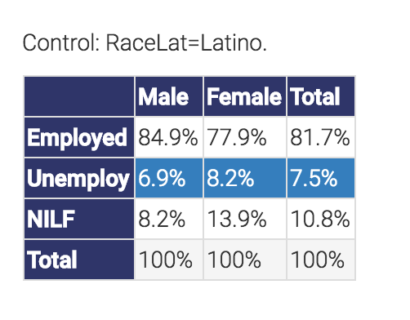
Evidence of racial differences in employment among women.
Asian women most likely to be employed, followed by Latina and white women, and then Black women. For example, 80% of Asian women are employed, compared with 76% of Black women. These data suggest that Black Americans have the lowest rates of employment among women.
Notes:
Now, use the data to examine whether there are racial differences in employment status among women. Explain to students that we have to compare the data from varying tables to examine this.

Slide 15
Evidence of racial differences in employment among men.
Latino men most likely to be employed, followed by Asian men, white men, and then Black men. For example, 81% of white men are employed, compared with 73% of Black men. These data suggest that Black Americans have the lowest rates of employment among men.
Notes:
Now, use the data to examine whether there are racial differences in employment status among men. Explain to students that we have to compare the data from varying tables to examine this.
I recommend ending the instructional lesson by describing the major findings from the analyses done.

